Slide 1


Hospital management system

Slide 2
Project members(group : 3)
NAMES EMP ID
1. Devarinti Manoj Kumar Reddy 2489514
2. Devyani Chandrashekhar Zade 2487344
3. Fardeen Khan 2489548
4. G Suprith 2485811
5. Gadiraju Suma 2487996
6. Gowthami V 2488948
7. Hanumalu Om Sesank 2488709
8. Himanshu Harimohan Dodwani 2489207
9. Hithashree C S 2488944
10. K Sai Deepthi 2488953

Slide 3

introduction
HMS is an integrated software that handles different directions of clinic workflows. It manages the smooth healthcare performance along with medical and financial control. That is a cornerstone for the successful operation of the healthcare facility.
Hospital management has greatly changed over the last decades. Business expertise, modern technologies, connected devices, mobile apps, and knowledge of healthcare are key elements for the implementation of hospital management system project.

Slide 4
Why Hospital Mangement System?
HMS was introduced to solve the complications coming from managing all the paper works of every patient associated with the various departments of hospitalization with confidentiality. HMS provides the ability to manage all the paperwork in one place.
HMS does many works like:
Maintain the medical records of the patient
Maintain the contact details of the patient
Keep track of the appointment dates
Tracking the bill payments.

Slide 5
Objective
Main objectives of a Hospital Management System are:
Design a system for better patient care.
Reduce hospital operating costs.
Provide Management Information System report on demand to management for better decision making.
Better co-ordination among the different departments.
Provide top management a single point of control.

Slide 6
Existing system
Hospitals currently uses a manual system for the management and maintenance of critical information . The current system requires numerous paper forms ,with data stores spread throughout the hospital management infrastructure.
Often information(on forms) is incomplete ,or does not follow management standards. Forms are often lost in transit between departments requiring a comprehensive auditing process to ensure that no vital information is lost.

Slide 7
Disadvantages of existence system
Lack of Security : The paper document is less secure compared to an electronic system.
Time Consuming : Manually managing is a very tough and time-consuming process
Insufficient Storage Space
Difficulty in a modification of data
Increases Cost

Slide 8
PROPOSED SYSTEM
The online hospital management system is available in the market that can serve patients to search doctors near by and take appointment and view our appointment status online.
ADVANTAGES
Revenue management
Role-Based access control
Increases data security & integrity
Digital medical records

Slide 9
Scope of hms
HMS can improve quality of patient care by increasing the timeliness and accuracy of records and administrative information.
HMS can also help eliminate confusion and delays that are caused by incomplete or missing records. These systems provide a managerial tool for decision making.
Hospital management information systems are secured databases of administrative and patient information that can be easily accessed only by those who need the information.

Slide 10

Modules for Hospital Management System
Admin
Doctor
Patient
AboutUs
FeedBack
ContactUs

Slide 11
ADMIN MODULE
In the Admin Module the Admin could login and signup .
The Admin can see the Doctor List, Patient List and Feedback List.
In the Doctor’s List the Admin can perform UPDATE and DELETE operation.
In the Patient’s List the Admin can perform DELETE operation.

Slide 12
PATIENT MODULE
Patient can Login and SignUp
Patient can see the Doctor List
Patient can Register the Appointment.
Patient can fill the form of Discharge Appointment
Patient can give the Feedback to the Doctor

Slide 13

SUB MODULES IN PATIENT:
DOCTORS
APPOINTMENTS
DISCHARGE SHEETS

Slide 14
DOCTOR MODULE
Doctor can Login and SignUp
Doctor can see the Appointment List and Discharge List
Doctor can DELETE the Appointment

Slide 15
SUB MODULES IN DOCTOR:
APPOINTMENTS
DISCHARGE PATIENT LIST

Slide 16
REQUIREMENT SPECIFICATION
FRONT END: BACK END:
ANGULAR MY SQL
HTML SPRING TOOL SUITE
CSS POSTMAN
BOOTSTRAP

Slide 18
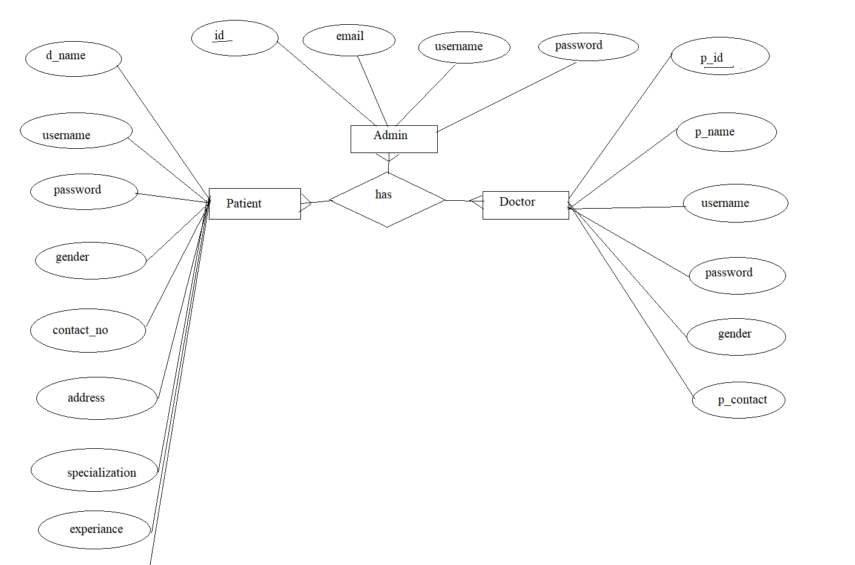
E-R DIAGRAM

Slide 19
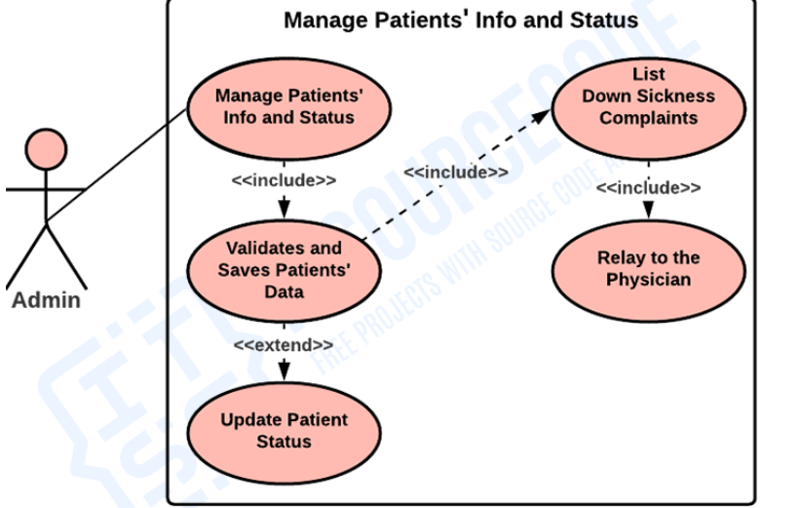
Usecase DIAGRAM

Slide 20

Advantages
Digital Medical Records
Less time consuming
Insurance claim functions
Patient self-service
Financial control and taxpaying
Staff interactions

Slide 21
TESTING
UNIT TESTING
Verify that for existing patients based on the application number of the patient, their records are added/updated in the database.
Verify that the system has an admin for doctors as well.
Verify that for each doctor's details is visible to the authorized users.

Slide 22
REST API Development
Creating Doctor Entity:
Create Spring Boot with Microservices Application with Spring Data JPA
❖ Technology stack:
• Spring Boot
• Spring REST
• Spring Data JPA
Here will have multiple layers into the application:
1. Create an Entity: Doctor
2. Create a Doctor Repository interface and will make use of Spring Data JPA
a) Will have findByDoctorId method.
b) Add the Doctor details
c)Delete Doctor By Id
d)Update Doctor Details
3. Create a Doctor Service class and will expose all these services.

Slide 23
Spring Boot Annotations:
@crossorigin
@requestmapping
@restcontroller
@Autowired
@getmapping
@postmapping
@putmapping
@deletemapping

Slide 24

Home page:

Slide 25
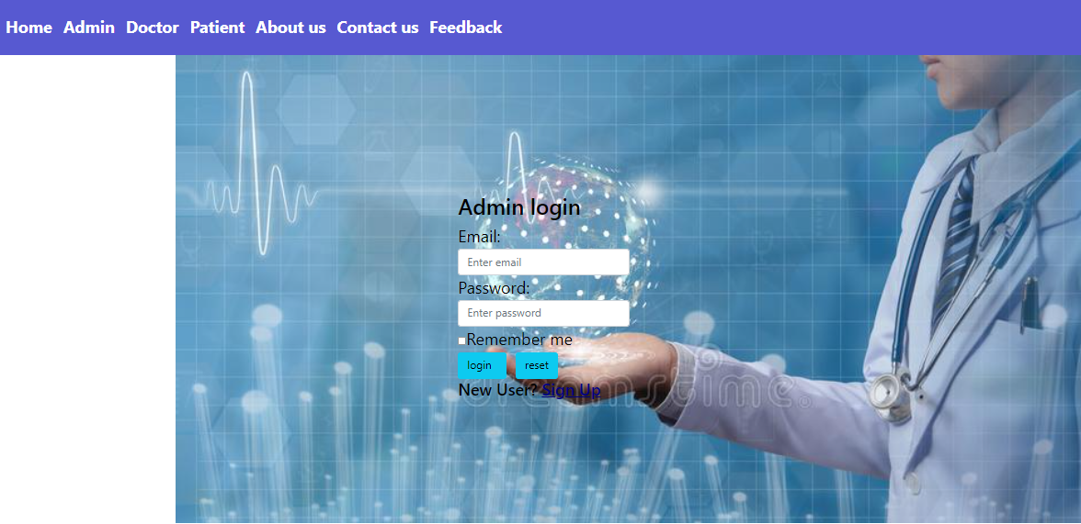
Admin login:

Slide 26

Doctor login:

Slide 27
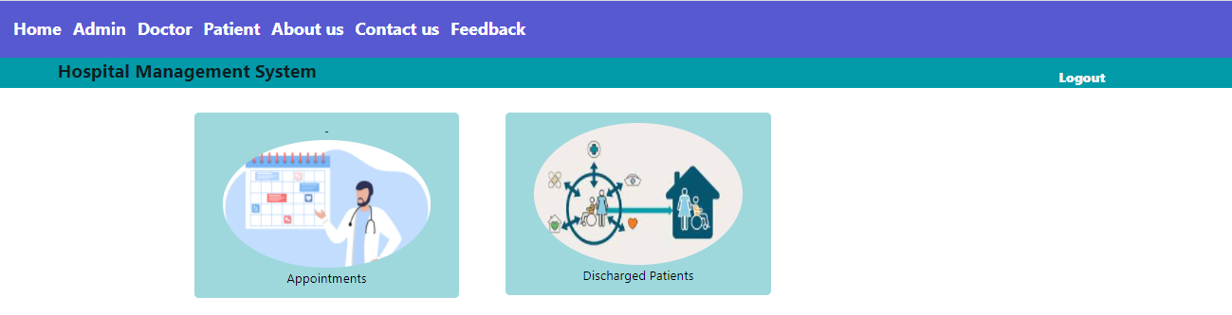
Doctor sub-modules:

Slide 28
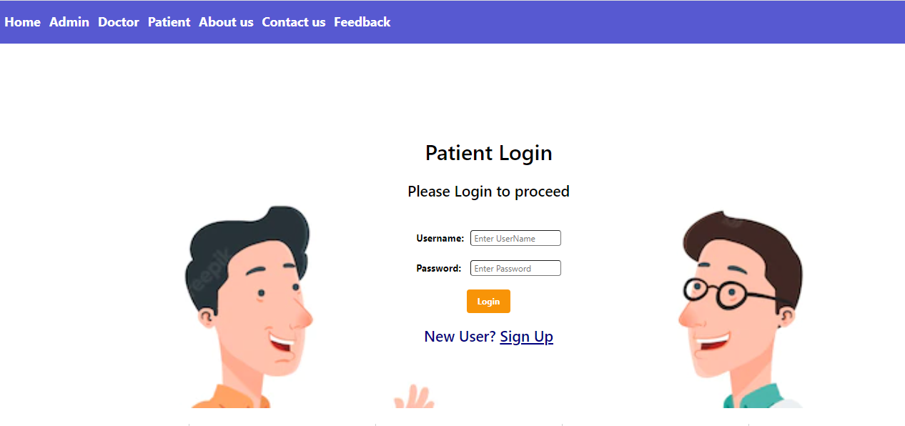
Patient Login:

Slide 29
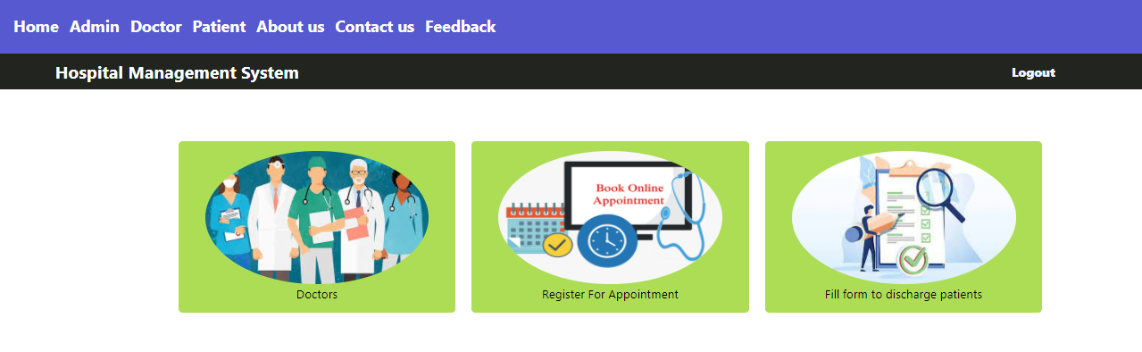
Patient sub-modules:

Slide 30
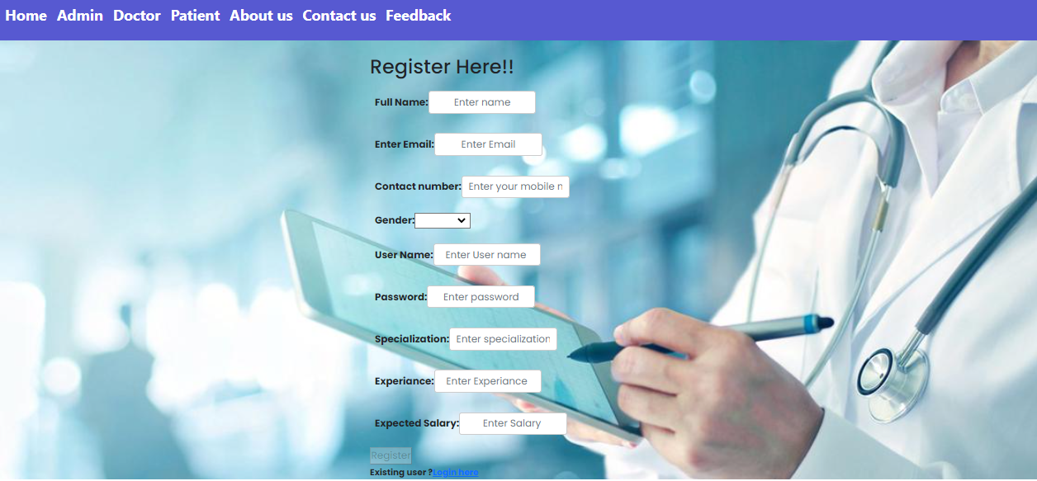
Doctor sign up:

Slide 31
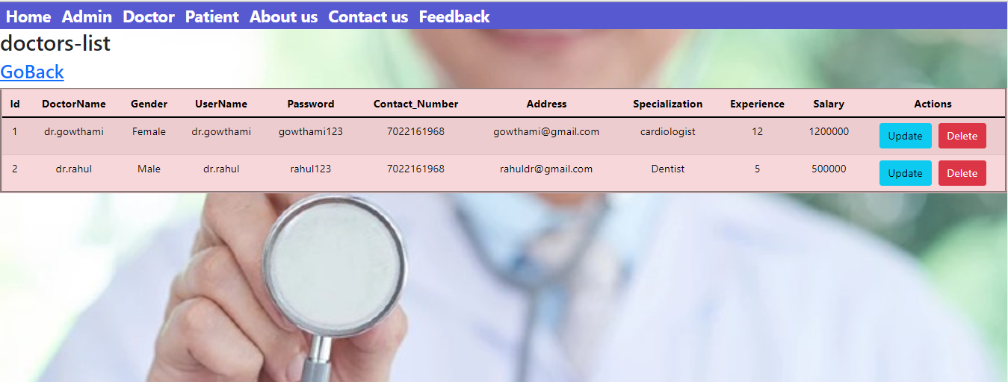
Doctor List:

Slide 32
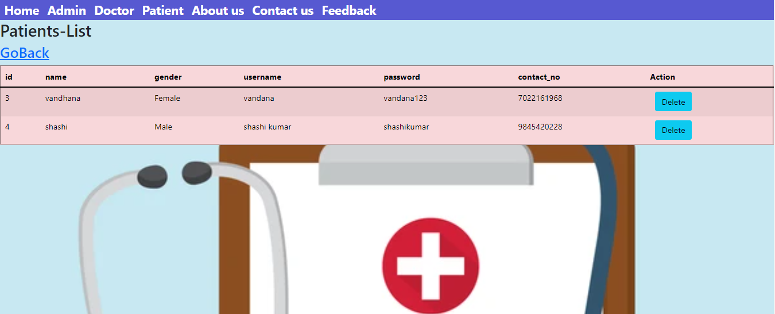
Patient List:

Slide 33
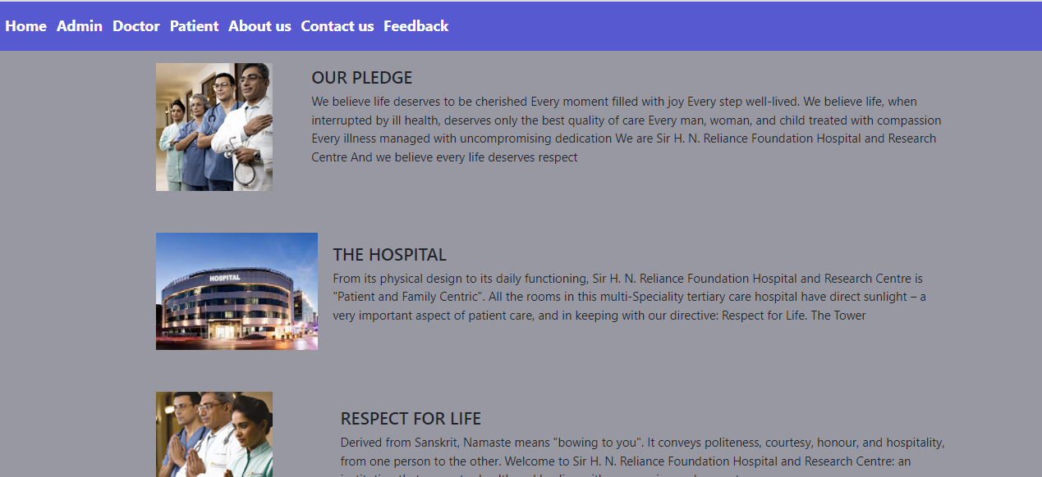
About us:

Slide 34
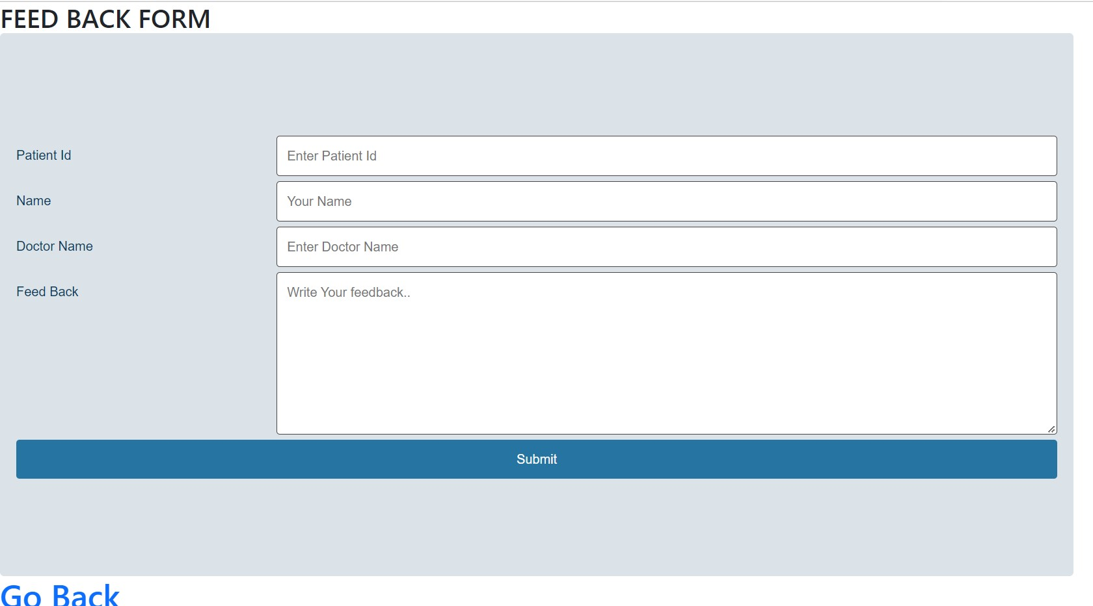
FEEDBACK:

Slide 35
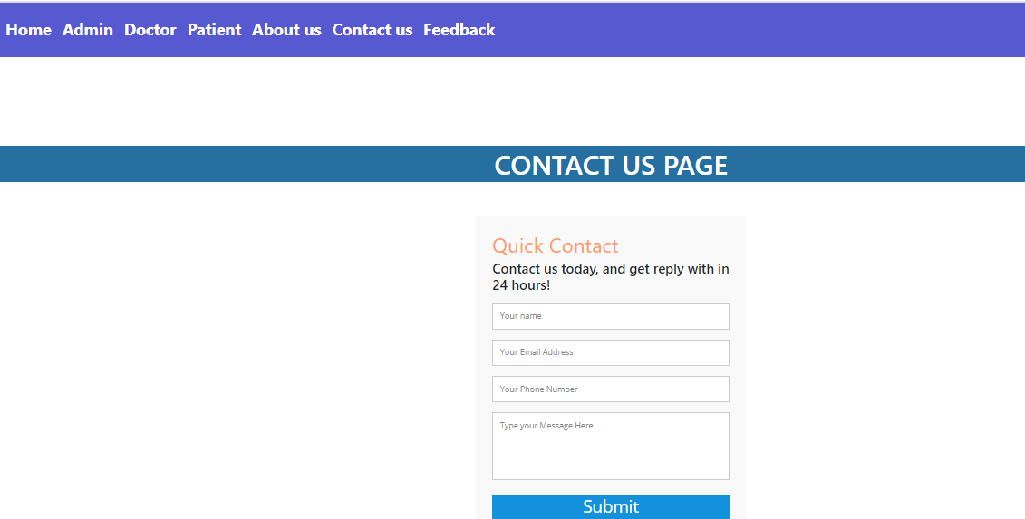
CONTACT US:

Slide 36
CONCLUsION:
Hospital management systems allows us the ability to optimize and digitize all the processes within the institution.
It will help to improve customer service, reduce process costs, streamline the search of medical records, bills, patients, doctors, etc.

Slide 37
FUTURE DEVELOPMENT SCOPES:
Optimization of Pathology lab.
Doctors touch attendance.
Bill payments.
Medicalm documents upload section.

Slide 38



